Slide 1
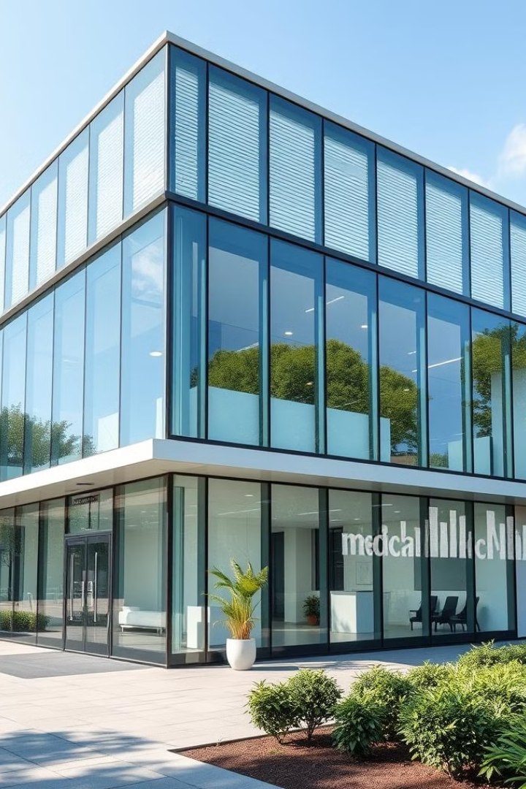
The Clinic Management System
The Clinic Management System is a comprehensive solution designed to streamline patient registration, scheduling, billing, and reporting, ensuring efficient and secure healthcare management.

Slide 2
Team members
Ahmed Mohamed Galal
Abdelhay Elkemary
Hussien Bakry
Kerolos Emad
Mohamed Hussien
Ahmed Hesham
Mahmoud Abbas

Slide 3
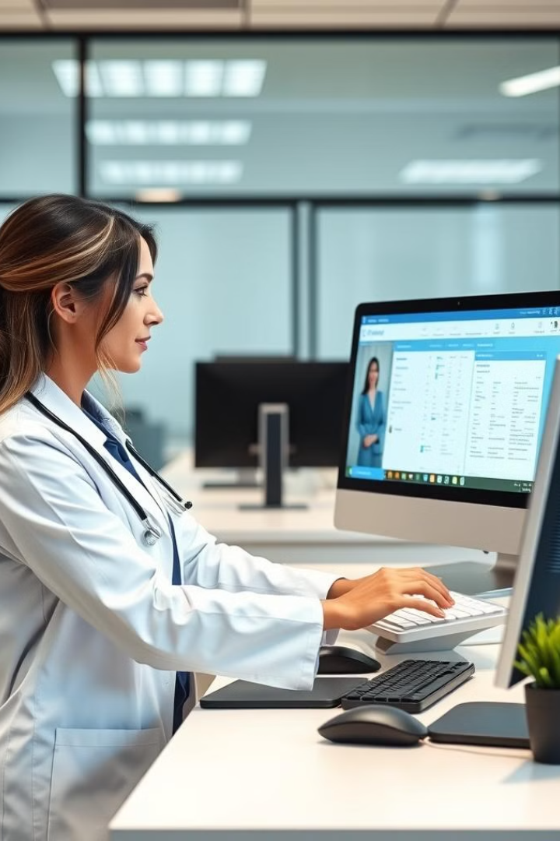
Robust Search Function
1
Quick Retrieval
2
Detailed Profiles
Clinic staff can easily search and access patient records using a variety of search criteria, including name, ID, and contact information.
The search function provides comprehensive patient profiles, including medical history, past appointments, and billing information.
3
Secure Access
The system ensures patient data is accessible only to authorized personnel, maintaining strict privacy and confidentiality standards.

Slide 4

Patient Registration and Management
Simple Interface
Unique Identification
Comprehensive Records
The system offers a user-friendly interface for clinic staff to easily add new patient records and update existing ones.
Each patient is assigned a unique ID, ensuring accurate and consistent data management across the clinic.
Patient profiles include detailed personal, contact, and medical information, providing a complete overview of each individual's healthcare history.

Slide 5

Appointment Scheduling and Management
1
Schedule Appointments
Clinic staff can easily book new appointments for patients, taking into account provider availability and patient preferences.
2
Manage Calendars
The system allows for seamless coordination of provider schedules, minimizing conflicts and ensuring efficient use of clinical resources.
3
Automated Reminders
Patients receive timely notifications and reminders for their upcoming appointments, reducing no-shows and improving overall patient engagement.

Slide 6

Streamlined Billing and Invoicing
Accurate Charges
Flexible Payments
The system automatically calculates charges based on the services provided, ensuring accurate billing and minimizing errors.
Patients can conveniently make payments online or in-person, with the option to set up payment plans for outstanding balances.
Comprehensive Reporting
HIPAA Compliance
The system generates detailed financial reports, allowing clinic managers to track revenue, monitor trends, and identify opportunities for improvement.
All financial transactions and patient data are handled in strict accordance with HIPAA regulations, ensuring the security and privacy of sensitive information.

Slide 7




Reporting and Analytics
Intuitive Dashboard
Advanced Analytics
Customizable Reporting
The system provides a comprehensive dashboard that presents key performance metrics and insights at a glance.
Clinic managers can leverage powerful analytics tools to identify trends, monitor KPIs, and make data-driven decisions.
The system allows for the generation of custom reports, enabling the clinic to tailor the information to their specific needs.

Slide 8




Secure and HIPAA-Compliant
Encrypted Data
Restricted Access
Regular Backups
All patient information is stored securely with industry-standard encryption, safeguarding against unauthorized access or data breaches.
The system implements role-based access controls, ensuring that only authorized personnel can view and modify patient records.
Comprehensive backup procedures are in place to protect against data loss and ensure the integrity of patient information.

Slide 9

Empowering Clinic Efficiency
The Clinic Management System is designed to streamline and optimize every aspect of healthcare management, from patient registration to billing and reporting. By leveraging advanced technology and robust security measures, the system empowers clinics to provide exceptional patient care and enhance operational efficiency.

Slide 10

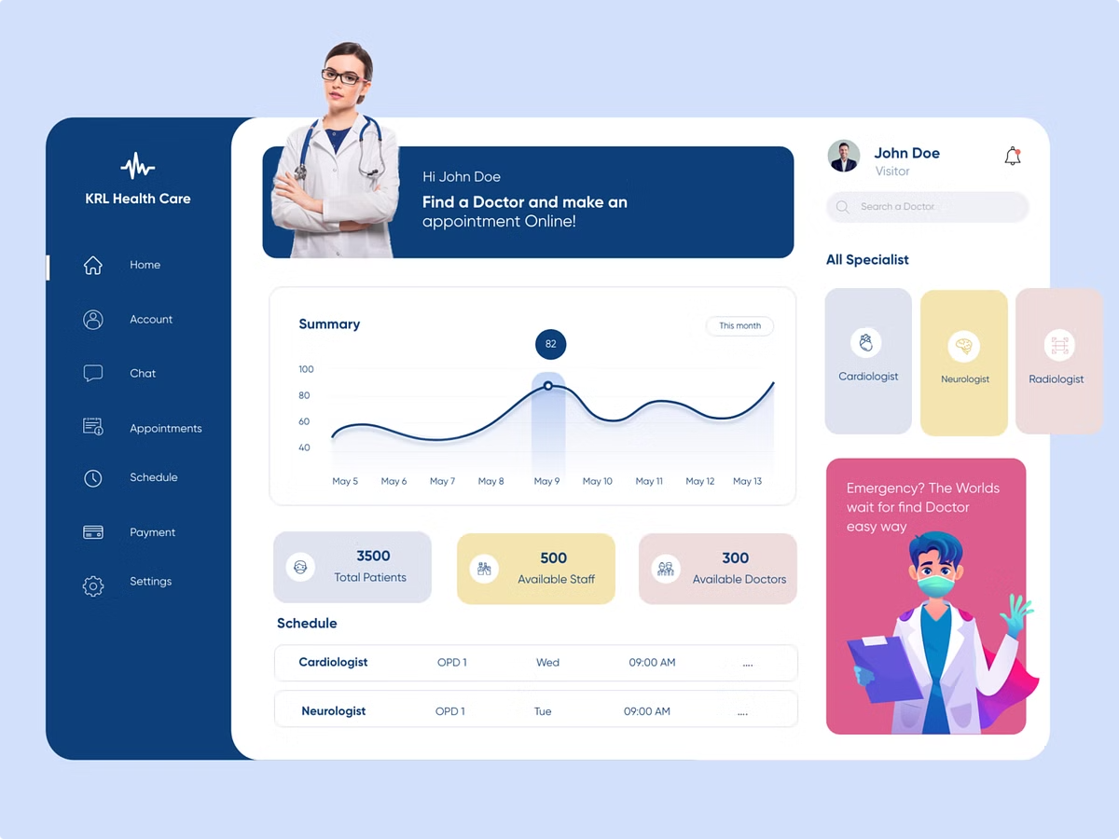
Clinic Management Project
This project divides the clinic management application development among six team members. will handle a specific module, fostering collaboration and clear responsibilities. Regular integration and communication are essential for project success.

Slide 11


Collaboration and Integration Strategies
1
Version Control with Git
Git enables efficient collaboration and version tracking. Branching and merging facilitate parallel development and integration.
2
Regular Communication
Consistent team communication ensures everyone stays informed. This is especially crucial for interconnected modules.
3
Integration Meetings
Regular meetings ensure smooth integration of components. Testing sessions validate the unified application's functionality.

Slide 12
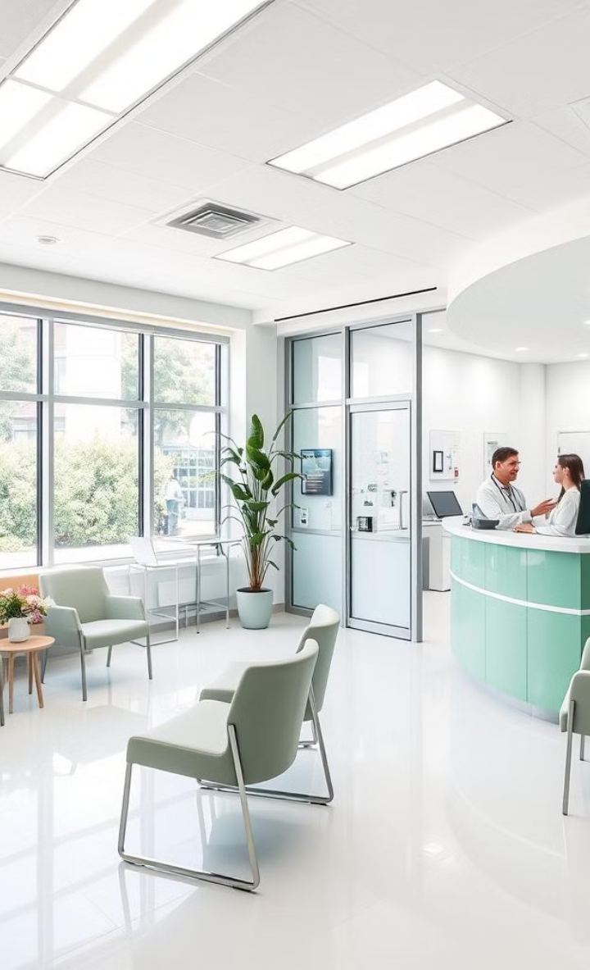
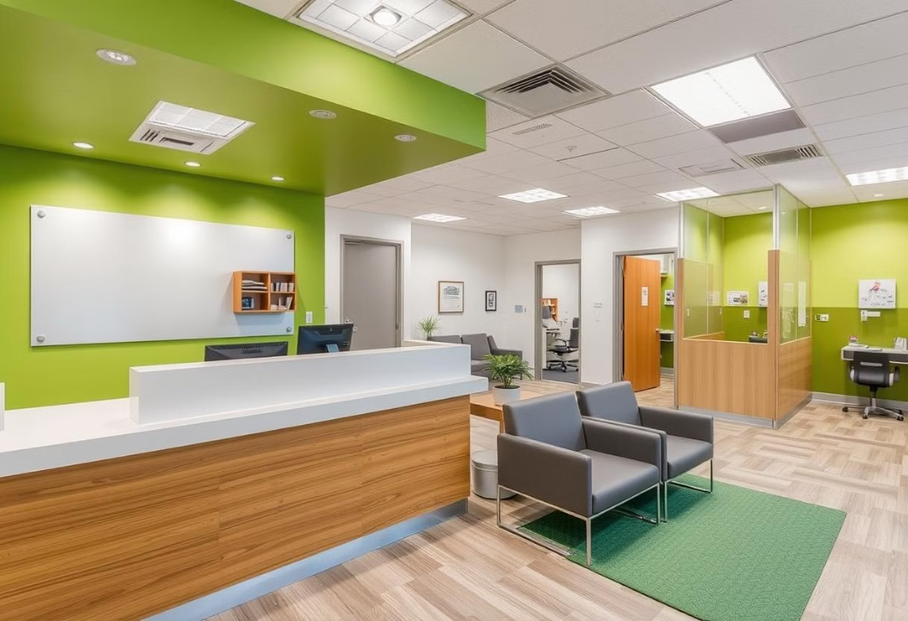
Clinic Workflow and Operations
The clinic management system streamlines patient flow, optimizing the journey from check-in to checkout. Integrated scheduling, medical records, and billing modules ensure efficient, patient-centric care.

Slide 13
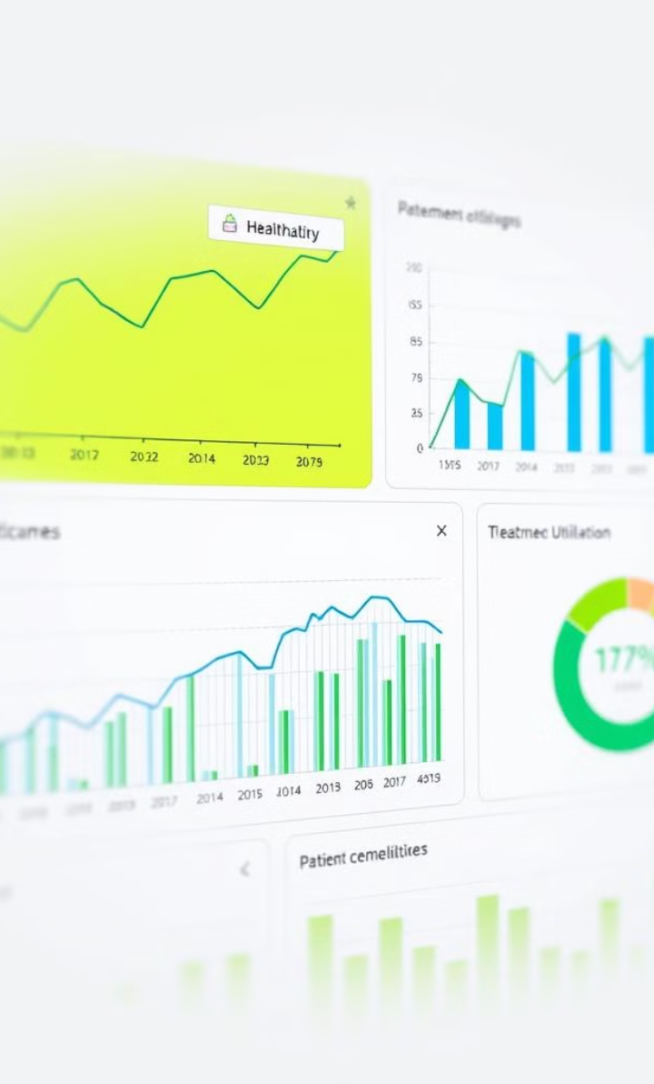
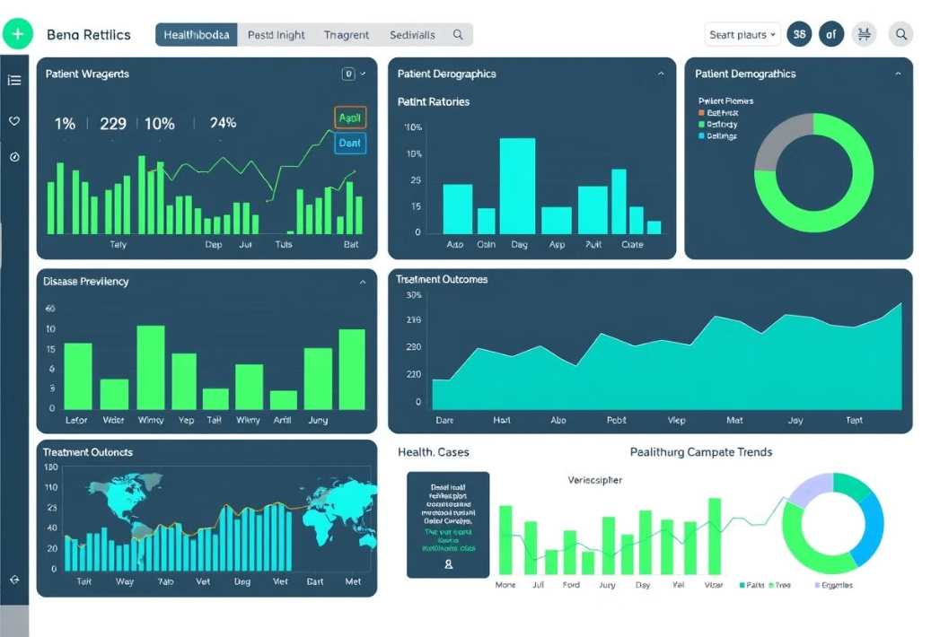
Data-Driven Insights
Advanced analytics capabilities provide deep visibility into clinic performance, patient outcomes, and resource utilization. Customizable dashboards empower stakeholders to make informed, data-driven decisions.

Slide 14


Collaborative Care
The clinic management system fosters seamless collaboration among healthcare providers, enabling real-time information sharing and joint decision-making for comprehensive patient care.
Integrated communication tools and task management features streamline interdisciplinary coordination, ensuring smooth transitions and continuity of care.

